Slide 1
PREDICTION OF FUEL EFFICIENCY
By
Battuta Naveen Kumar

Slide 2
OBJECTIVES
Aim of the Project:
Our main objective was to predict the vehicle’s fuel efficiency or the MPG(Miles per gallon).
Scope of the Project:
The scope of the project is to develop a Machine Leaarning Model that gives better attributes i.e proprties of a vehicle for fuel efficiency.

Slide 3
INTRODUCTION
The automotive industry is an industry which is extremely competitive. With increasing fuel prices and picky consumers,automobile makers are constantly optimizing their processes to increase fuel efficiency .
But, what if you could have a reliable estimator for a car's mpg given some known specifications about the vehicles?
Then you could beat a competitor to market by both having a more desirable vehicle that is also more efficient,reducing wasted costs and gaining large chunks of the market.
Utilizing Machine learning,we build prediction model designed to give an edge over company competitors.

Slide 4
DESIGN AND METHODOLOGIES
MODULE 1:
Data collection and training using machine learning Algorithms
MODULE 2:
Preprocessing data
MODULE 3:
Building Model

Slide 5
MODULE:1
Data collection :
The dataset used for this project currently contains information about the vehicle from which a set of samples have been collected as the training set to get accurate outputs.
We get the data with following attributes :
Mpg
Cylinders
Displacement
Horsepower
Weight
Acceleration
Model
Year
Origin

Slide 6
MODULE:2
Preprocessing of Data :
Here in our dataset there are some null values.so we have done the data preprocessing to make the dataset free from null values.
We plot some box plots to find the median and properties like minimum, first quartile,median,third quartile and maximum

Slide 7
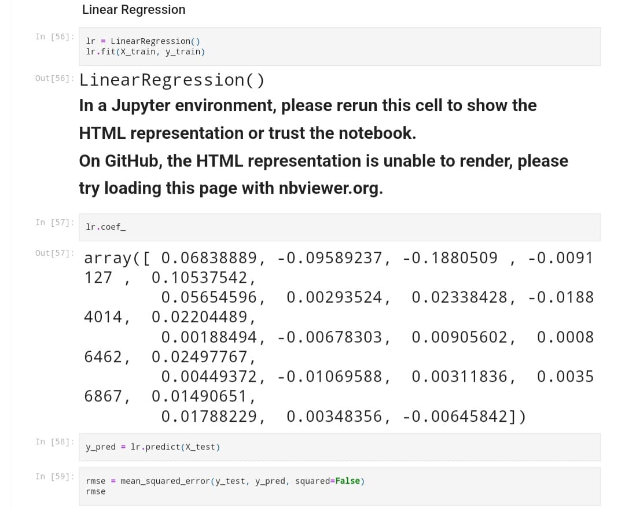
MODULE:3 Building Model
Apply Machine learning Algorithm

Slide 8
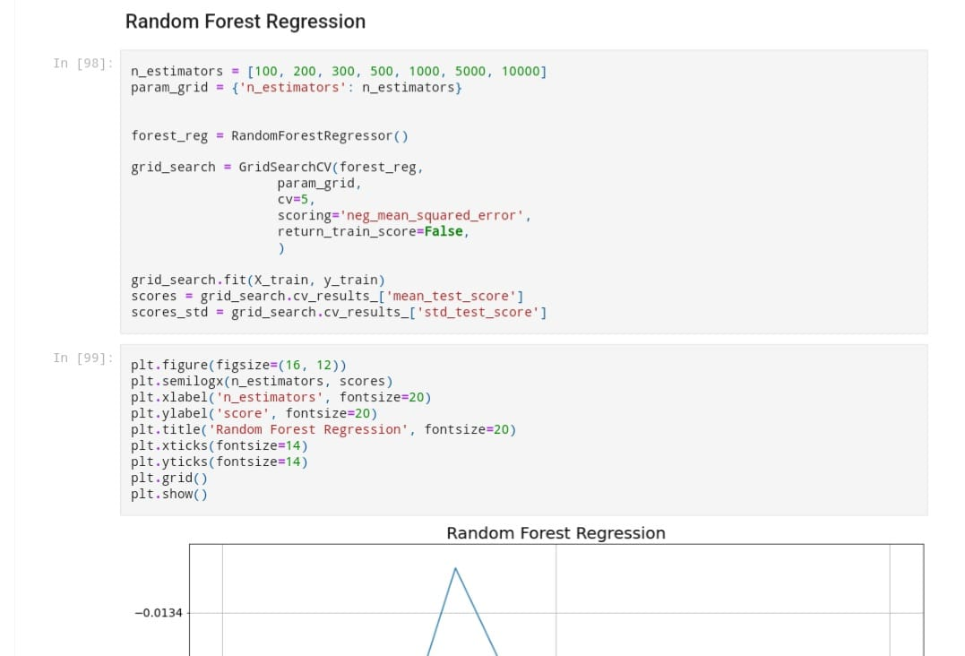
MODULE:3 Building Model
Apply Machine learning Algorithm

Slide 9
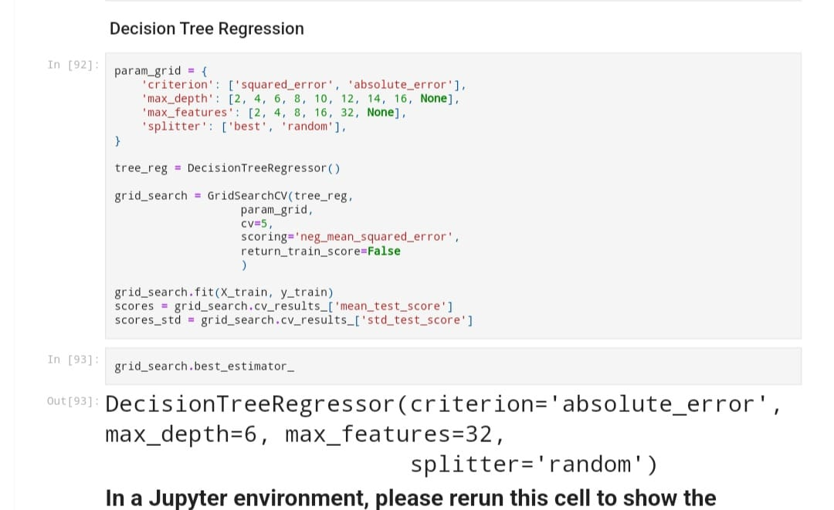
MODULE:3 Building Model
Apply Machine learning Algorithm

Slide 10
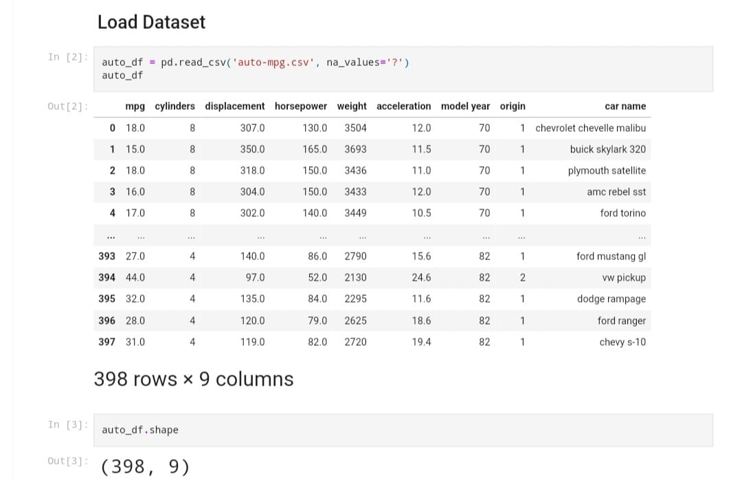
INPUT AND OUTPUT INPUT :

Slide 11
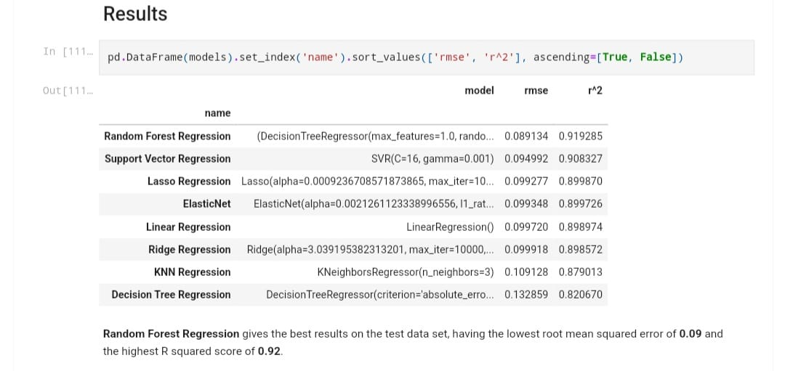
OUTPUT :

Slide 12
CONCLUSION:
Fuel prices are increasing rapidly each day,and the demand of vehicles with better fuel efficiency is growing tremendously.
During this project our main objective was to predict the vehicles fuel efficiency. We have done the data preprocessing to make the dataset free from null values and other disturbances, then we performed data visualization of the data represent and know well about the attributes in the dataset.we have implemented various machine learning models and checked for their errors and accuracies until we get the best effective model for the data taken.
Fuel-Efficient cars emit less pollution over the same amount of distance travelled.They also cost less to operate.Buying a more Fuel-Efficient car can save you thousands of dollars on fuel costs over time and can often balance out a higher purchase price if you keep the car long enough.

